Slide 1

End-to-End Data Transformation: Data Warehouse Modeling (Star Schema) and dbt

Slide 2
Introduction to End-to-End Data Transformation
Data transformation is the process of converting raw, data into a clean, structured, and usable format for analytical purposes and reporting. It ensures data quality, consistency, and readiness for downstream consumption.
In modern data architectures, especially with cloud platforms, transformation frequently occurs directly within the data warehouse, leveraging its immense processing power.
Why is transformation critical?
Raw data is rarely suitable for direct analysis. It often contains inconsistencies, missing values, incorrect data types, and is structured for operational systems, not analytical queries. Transformation addresses these issues, making data reliable and performant for business intelligence and data science.

Slide 3
ELT vs. ETL
ETL (Extract, Transform, Load) - Traditional Approach
Raw data extracted from sources (e.g., transactional databases, flat files).
Transformed in a separate staging area or dedicated transformation server. This often involved custom scripts or specialized ETL tools.
Loaded into the data warehouse only after all transformations are complete.
Challenges: Often resource-intensive, rigid, and less flexible for evolving business needs. Requires pre-defined schemas and transformations before loading.
ELT (Extract, Load, Transform) - Modern Approach
Raw data extracted and loaded directly into a powerful, scalable data warehouse or data lake (e.g., Snowflake, BigQuery, Redshift, Databricks).
Transformations performed *within* the data warehouse, leveraging its scalable compute resources (SQL-based transformations).
Offers enhanced flexibility (transform on demand), superior scalability (leverage cloud elasticity), and retention of raw data for future, unforeseen analytical needs.
Loading and transformation can occur in parallel, significantly speeding up the data pipeline.

Slide 4
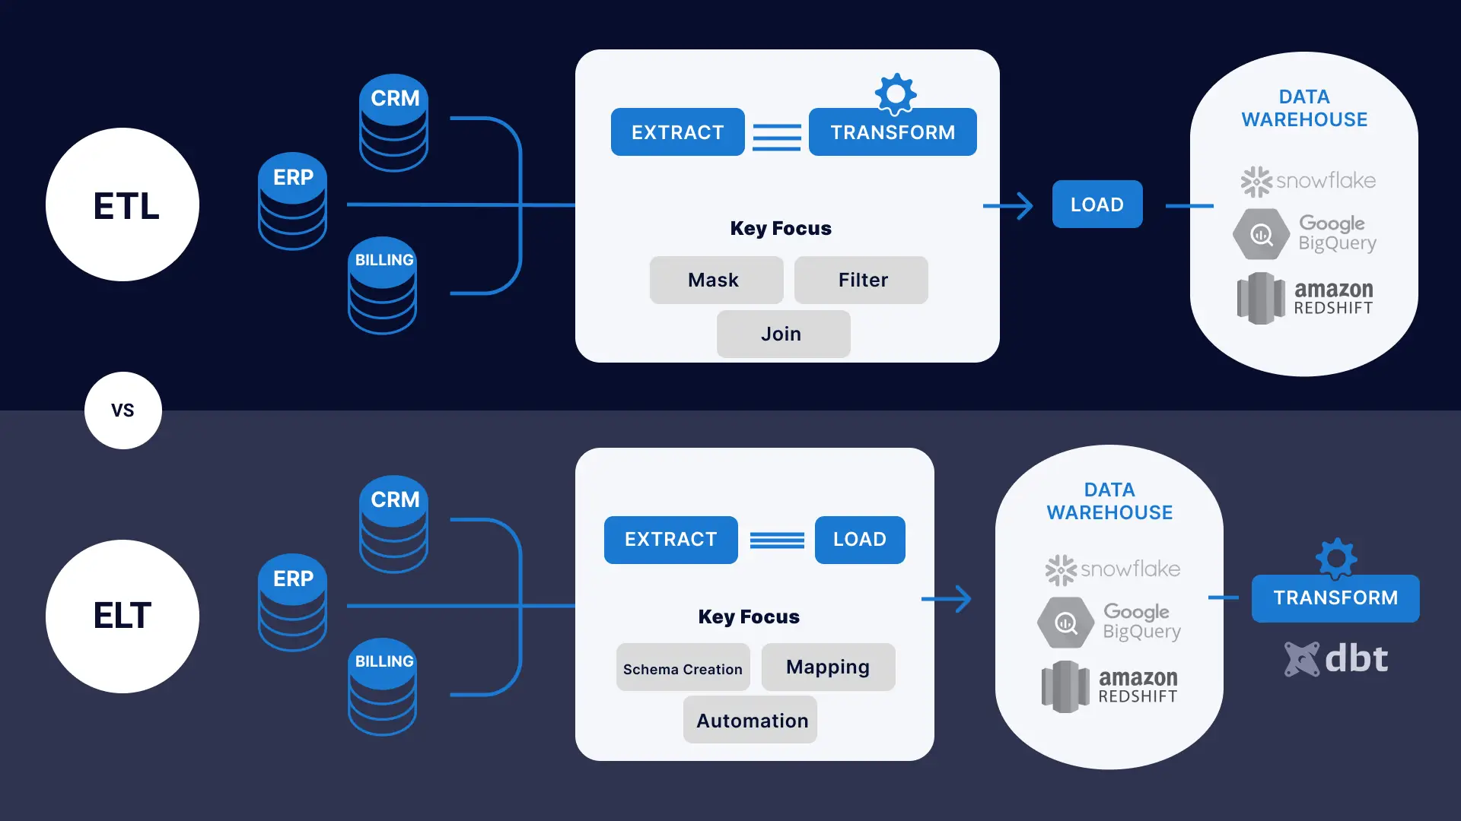
Sub-title
text

Slide 5
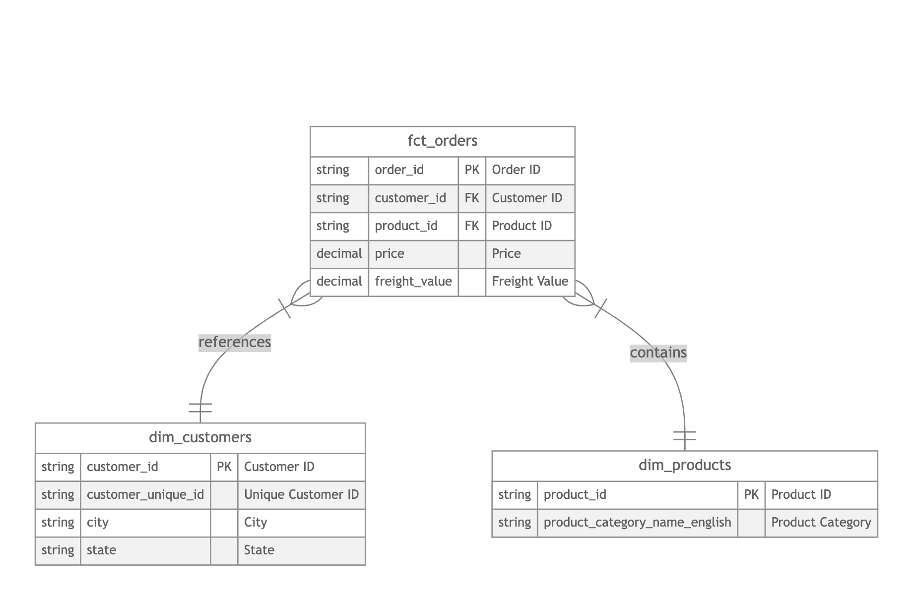

Slide 6
Data Warehouse Modeling: The Star Schema
Foundations of Dimensional Modeling (Kimball's Principles)
Dimensional modeling is a logical design technique for structuring data warehouses, specifically optimized for analytical queries and business intelligence reporting.
It prioritizes understandability, query performance, and extensibility over the strict normalization found in transactional databases.
Core concepts: Facts (numerical measures representing business events) and Dimensions (contextual attributes that describe the facts).
Kimball's Four-Step Design Method:
Choose the business process: Identify the specific operational process or business area to analyze (e.g., sales, inventory, customer service interactions). This defines the scope of your data warehouse.
Declare the grain: Determine the lowest, most atomic level of detail for the fact table. This is crucial for analytical flexibility. For example, for sales, the grain might be "one row per individual sales transaction line item," allowing for detailed analysis rather than just "one row per order."
Identify the dimensions: Define the descriptive attributes that provide context to the facts. These are typically nouns representing entities like product, customer, time, store, or employee. Dimensions answer "who, what, where, when, why, how."
Identify the facts: Pinpoint the numerical, quantitative metrics that will populate the fact table. These are typically additive measures that can be summed, averaged, or counted (e.g., quantity sold, total sales amount, profit, duration).

Slide 7
What is a Star Schema?
The star schema is the simplest and most widely used dimensional modeling technique. It consists of a central fact table surrounded by multiple dimension tables, visually resembling a star. This structure is highly optimized for analytical workloads.
Purpose:
Simplify complex analytical queries for business users and BI tools.
Optimize query performance by minimizing joins and leveraging denormalization.
Provide an intuitive and understandable data model that mirrors business processes.
Key Benefits:
Simpler Queries: Reduces the number of joins required compared to highly normalized schemas, making SQL queries easier to write and faster to execute.
Improved Query Performance: Denormalized dimension tables mean fewer joins are needed, leading to significantly faster query execution, especially for large datasets. This is critical for interactive BI dashboards.
Facilitates Data Aggregation and Reporting: The clear separation of facts and dimensions makes it easy to "slice and dice" data, allowing analysts to quickly summarize metrics across various attributes (e.g., total sales by region and product category).
Scalability and Flexibility: New attributes can be added to existing dimension tables, or entirely new dimension tables can be introduced without fundamentally altering the core fact table structure. This adaptability supports evolving business requirements.
Enhanced Understandability: The intuitive, star-like structure closely aligns with how business users think about their data, promoting greater data literacy and self-service analytics.

Slide 8
Core Components: Fact Tables
The central table in a star schema, representing a business event (e.g., a sale, a login, an inventory movement).
Stores numerical, quantitative data (measures or facts) that can be aggregated.
Contains foreign keys that link to the primary keys of surrounding dimension tables, providing contextual lookup.
Typically has a high number of rows (millions to billions) but relatively fewer columns.
Granularity: Defines the level of detail for each row (e.g., "one row per sales transaction line item" or "one row per daily website visit"). Choosing the right grain is paramount for analytical flexibility.
Measures: Generally additive (can be summed across any dimension, like `quantity_sold`, `total_sales_amount`), semi-additive (can be summed over some dimensions but not all, like `account_balance`), or non-additive (cannot be summed, like `unit_price`).
Usually appended with new data, rather than updated in place, reflecting the historical nature of business events.

Slide 9
Core Components: Dimension Tables
Tables that surround the fact table, providing descriptive context to the numerical measures.
Store descriptive, qualitative information (attributes) about entities involved in a business process.
Used for filtering, grouping, and categorizing data in analytical queries (e.g., "show me sales for products in the 'Electronics' category").
Each dimension table has a primary key (often a surrogate key) that links to a foreign key in the fact table.
Generally smaller than fact tables in row count but can have many columns.
Typically denormalized (e.g., `product_category` might be stored directly in `dim_product` instead of a separate category table) for faster query execution by reducing the need for joins.
Crucial for maintaining historical data for attributes that change over time (Slowly Changing Dimensions - SCDs).

Slide 10
Designing Your Star Schema: A Practical Step-by-Step Guide
Identify Business Processes and Declare the Grain:
Start by deeply understanding the business questions you need to answer. For example, if the goal is "analyze daily sales performance by product and customer," the business process is "sales." The grain would then be "one row per sales transaction line item," as this is the most atomic level of detail needed to answer the questions.
Define Fact Tables:
Based on the chosen grain, identify the measurable events and their associated numerical metrics. For the sales example, the fact table would be `fct_sales` containing `quantity_sold`, `unit_price`, `total_sales_amount`, etc. Ensure these facts are additive or semi-additive where possible.
Create Dimension Tables:
Identify all the descriptive attributes that provide context to your facts. For `fct_sales`, you'd need `dim_product` (product name, category, brand), `dim_customer` (customer name, city, loyalty status), `dim_date` (day, month, year), and `dim_store` (store name, region). Denormalize these dimensions to include all relevant attributes directly, even if it means some data redundancy, to optimize query performance.
Establish Relationships:
Link the fact table to its dimension tables using foreign keys. For instance, `fct_sales` would have `product_id`, `customer_id`, `date_id`, and `store_id` as foreign keys, each referencing the primary key of its respective dimension table. It's best practice to use surrogate keys (system-generated, non-business keys) for dimension primary keys to handle Slowly Changing Dimensions (SCDs) effectively.
Validate the Schema:
Critically review the designed schema with business users, analysts, and other stakeholders. Ensure it accurately reflects business logic, is intuitive to query, and can answer all the required analytical questions efficiently. This iterative feedback loop is crucial for a successful data warehouse design.

Slide 11
dbt: The Transformation Powerhouse for Your Data Warehouse
dbt (data build tool) is designed specifically for the "Transform" stage of the ELT process.
SQL-first approach: It enables data analysts and engineers to write modular SQL queries to transform raw data into analytics-ready datasets directly within their data warehouses. This empowers SQL-proficient teams to own the transformation layer.
Software engineering best practices: dbt integrates principles like version control (via Git), modularity, testing, and documentation into data transformation. This elevates data modeling from a scripting task to a robust engineering discipline.
Dependency management: It automatically builds a Directed Acyclic Graph (DAG) of your data models, ensuring transformations run in the correct order based on their dependencies.
Fosters collaboration: By standardizing the transformation process and integrating with version control, dbt allows multiple team members to collaborate on data models effectively, reducing silos and ensuring consistency.
Single source of truth: It helps establish a single, documented source of truth for key business metrics and definitions, reducing discrepancies across reports and increasing trust in data.
dbt doesn't extract or load data; it focuses solely on the transformation layer once data is in your warehouse.

Slide 12
Structuring Your dbt Project for Scalability and Maintainability
dbt advocates for a layered approach to data modeling, which significantly enhances scalability, maintainability, and reusability. This typically involves distinct layers: `staging`, `intermediate` (optional, for complex multi-step transformations), and `marts`.
Staging Models: Initial Cleaning and Standardization
Purpose: The first layer of transformation. Direct interface with raw data sources.
Functions: Perform essential cleaning (e.g., handling nulls, removing duplicates), data type casting (e.g., converting text to integers), column renaming (e.g., `transaction_id` to `sale_id`), and light restructuring.
Output: Provides a clean, standardized, and consistent view of raw data, making it ready for more complex transformations downstream.
Referencing Sources: Typically use `{{ source('source_name', 'table_name') }}` to reference raw tables defined in a `sources.yml` file. This helps dbt build lineage from raw data.
Materialization: Often materialized as `views` to avoid unnecessary storage, as they are typically consumed by downstream models rather than directly queried by end-users.

Slide 13
Cont.
Dimension Models: Building Descriptive Context
Purpose: Create the dimension tables that provide descriptive context for your fact tables in the star schema.
Functions: Often involve joining and transforming data from one or more staging models (or other intermediate models) to consolidate all relevant descriptive attributes into a single, denormalized table.
Output: Define `dim_` tables (e.g., `dim_product`, `dim_customer`, `dim_date`, `dim_store`) that contain rich, contextual information about entities.
Referencing Upstream Models: Use `{{ ref('model_name') }}` to reference upstream dbt models (e.g., staging models). This automatically builds the dependency graph, ensuring dbt runs models in the correct order.
Surrogate Keys: Best practice to generate surrogate keys (non-business primary keys) for dimensions to manage Slowly Changing Dimensions (SCDs) and decouple from source system keys.
Materialization: Typically materialized as `tables` for efficient querying, as they are frequently joined with large fact tables.

Slide 14
Cont.
Fact Models: Aggregating Business Metrics
Purpose: Create the central fact tables of your star schema, containing the core business metrics.
Functions: Typically involve joining dimension models with staging or intermediate models to bring together all necessary keys and measures at the defined grain. Calculations for derived metrics (e.g., net sales amount from gross sales and discount) are performed here.
Output: The `fct_` tables (e.g., `fct_sales`, `fct_orders`) that serve as the primary tables for analytical queries and reporting.
Granularity: Aligned with the chosen grain of the business process (e.g., one row per line item).
Materialization: Often materialized as `tables` or `incremental` models, especially for very large datasets, to optimize performance and reduce build times.

Slide 15
Cont.
Leveraging dbt Macros for Reusable Logic
Definition: Reusable blocks of SQL or Jinja logic, similar to functions or stored procedures in traditional databases.
Benefits:
DRY Principle: Reduces redundancy by centralizing common logic, making code more maintainable.
Standardization: Ensures consistent application of business rules and transformations across the project.
Simplification: Abstracts complex SQL patterns into simple, callable functions.
Flexibility: Can accept arguments, allowing for dynamic SQL generation.
Location: Macros reside in the `macros/` directory of your dbt project.
Use Cases: Data type conversions, string cleaning, date calculations, generating boilerplate SQL, implementing custom logic.

Slide 16
dbt Tests
dbt provides a robust testing framework to validate data quality and ensure transformations adhere to business rules. Tests are SQL queries designed to return "failing" records; if a test returns zero rows, it passes.
Built-in Generic Tests:
These are common, reusable tests applied directly in `schema.yml` files:
not_null: Ensures a column does not contain any NULL values. Essential for primary keys and critical attributes.
unique: Verifies that all values in a column are distinct. Crucial for primary keys to ensure each record is uniquely identifiable.
accepted_values: Validates that all values in a column are from a predefined list. Useful for categorical data (e.g., `status` column should only contain 'active', 'inactive', 'pending').
relationships (referential integrity): Checks that foreign key values in one model have corresponding primary key values in a referenced model. Ensures data consistency across tables (e.g., every `product_id` in `fct_sales` exists in `dim_product`).

Slide 17
Documentation as Code
Document models, columns, and sources directly within YAML files (`schema.yml`) alongside your SQL definitions.
Benefits:
Synchronization: Ensures metadata is always in sync with the actual data definitions.
Discoverability: Makes it easy for anyone to understand what data means, its purpose, and its lineage.
Collaboration: Improves teamwork by providing a shared understanding of data assets.
Single Source of Truth: Establishes an authoritative source for business definitions and data context.
Onboarding: Accelerates the onboarding of new team members who can quickly grasp the data landscape.

Slide 18
Key Best Practices
Star Schema Design Best Practices:
Choose the right grain: Always model fact tables at the lowest possible atomic level of detail. This provides maximum analytical flexibility and prevents the need for costly re-modeling if more granular questions arise.
Descriptive dimensions: Ensure dimension tables are rich with all necessary attributes. These attributes provide the "who, what, where, when, why, how" for your facts, enabling comprehensive analysis.
Use surrogate keys: Implement artificial, system-generated primary keys for dimension tables. This decouples your data warehouse from source system key changes and is essential for managing Slowly Changing Dimensions (SCD Type 2) to track historical attribute changes.
Balance normalization/denormalization: While dimensions are denormalized for query performance, avoid excessive redundancy that could lead to data integrity issues. The goal is to optimize for analytical reads.
Conformed Dimensions: Reuse the same dimension definitions across multiple fact tables where appropriate (e.g., `dim_date` should be consistent across all fact tables). This ensures consistency in reporting across different business processes.

Slide 19
Cont.
dbt Implementation Best Practices:
Layered modeling: Strictly adhere to a clear `raw` → `staging` → `intermediate` (if needed) → `marts` structure. This modularity improves maintainability, reusability, and understanding of the data pipeline.
Consistent naming conventions: Establish and enforce clear, consistent naming conventions for all models (`stg_`, `int_`, `fct_`, `dim_`), columns, macros, and files. This significantly improves readability and collaboration.
Leverage `ref()` and `source()`: Always use dbt's built-in `{{ ref() }}` and `{{ source() }}` functions. They automatically manage dependencies, build the DAG, and provide invaluable data lineage, making your project robust and transparent.
Write comprehensive tests: Implement a robust testing strategy using both dbt's built-in generic tests and custom tests tailored to your specific business rules. This is crucial for ensuring data quality, validating transformations, and building trust in your data assets.
Document everything: Utilize dbt's built-in documentation features (`schema.yml`) to describe your models, columns, and sources. "Documentation as code" keeps metadata in sync with definitions and serves as a single source of truth.
Use macros for reusability: Abstract common SQL logic or complex Jinja patterns into dbt macros. This reduces code duplication, standardizes transformations, and simplifies maintenance.
Version control: Manage your entire dbt project in a Git repository. This is a fundamental software engineering best practice enabling collaboration, change tracking, code reviews, and easy rollbacks.
Incremental Models: For large fact tables, consider using dbt's incremental materialization to only process new or changed data, significantly reducing build times and compute costs.

Slide 20
Conclusions
The modern ELT paradigm, enabled by scalable cloud data warehouses, signifies a major evolution in data engineering. It prioritizes analytical reads and raw data retention, offering unparalleled flexibility and efficiency in handling vast datasets.
Dimensional modeling, particularly the star schema, remains the cornerstone of effective analytical data design. Its intuitive structure simplifies queries, optimizes performance, and enhances the understandability of complex business data, making it ideal for business intelligence and reporting.
dbt is the pivotal tool for the "Transform" stage in ELT. By integrating software engineering best practices with a SQL-first approach, dbt empowers data teams to build robust, testable, and well-documented data models. It fosters collaboration, ensures data quality through comprehensive testing, and establishes a single source of truth for critical business metrics.
Mastering these concepts—ELT, Star Schema, and dbt—provides organizations with a scalable, trustworthy, and agile data foundation, essential for driving informed decision-making and unlocking the full potential of their data assets.

Slide 21
References
Demo GitHub
What Is Extract, Load, Transform (ELT)?
ELT in Data Warehouse (ETL and ELT: Points to Compare)
Mastering Star Schema in Big Data
Difference between Fact table and Dimension table?
How to Write a dbt Model in SQL: Examples & Best Practices
dbt docs generate & serve: Command Usage and Examples
dbt Docs

Slide 22
Any questions?

